Slide 1
Engineering Documents (ED) Other Functions
RNTBCI EDMS AMO Team

Slide 2
Table Of Contents
1.Revise Document Version
2.Edit Document attribute
3.Edit attribute of attachment
4.Replace/Remove attachment
5.Download attachment of Document
6.Delete Document / Attachment file
7.URL Share
8.Recently Viewed
9.Favorite
10. EDMS RL Analytics (For IS/IT, Biz Admin)

Slide 3
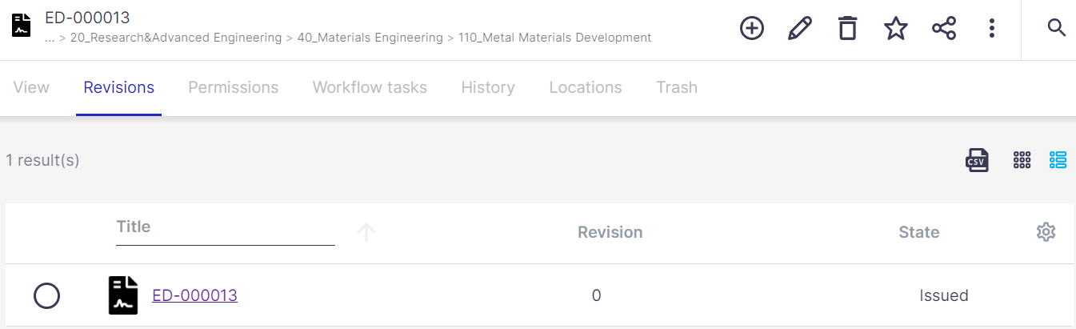
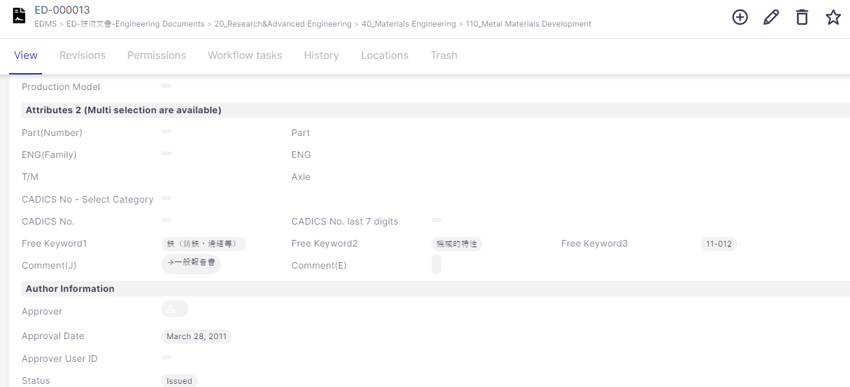
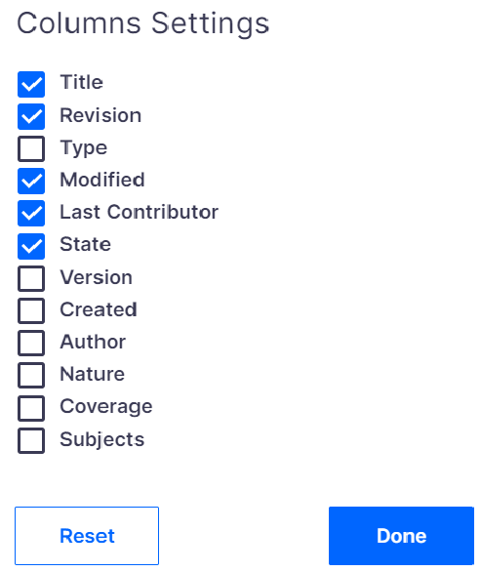
1.Revise Document Version
You can update version of Document from 0→１→２… as below steps.
※Condition to update version: Status of latest version is [Issued].
※ Author of the document set can only revise the issued document set.
③
③ Click [Revisions] tab
①
① Click [View] Tab
④
④Confirm that target document is the latest version and status is [Issued]
②
If [Revisions] +[State] column are not displayed, you can click on this icon in right side and check ON target column to show
②Confirm Status is [Issued]

Slide 4
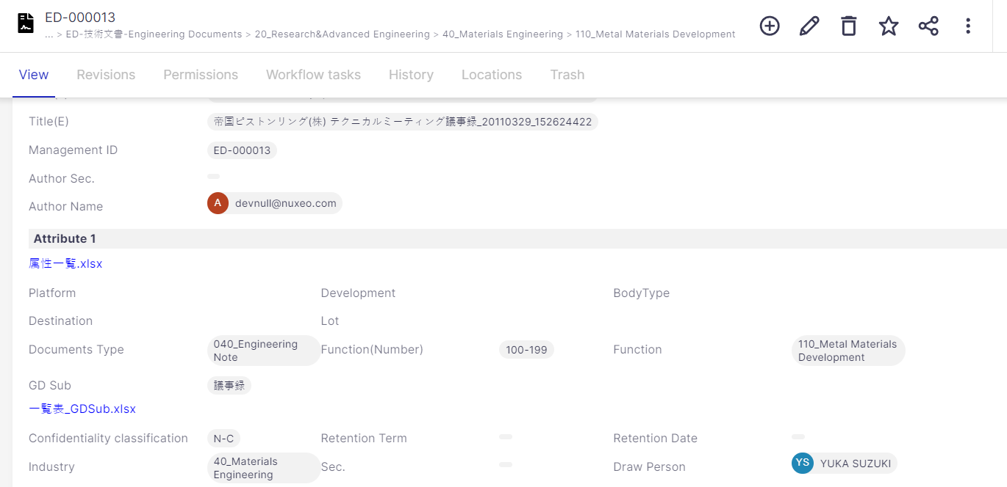
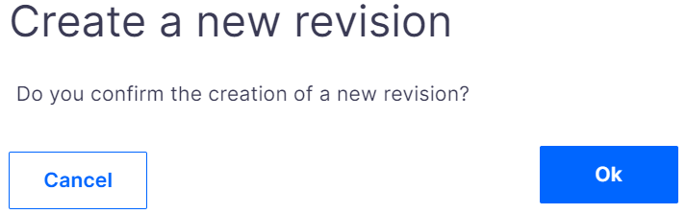
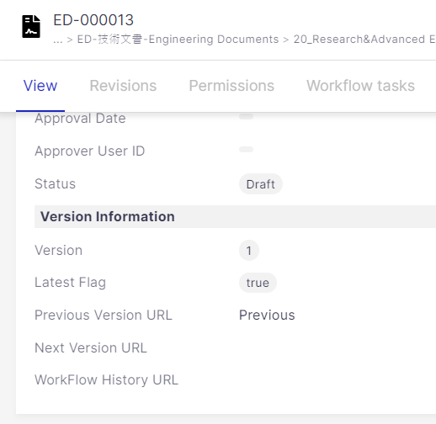
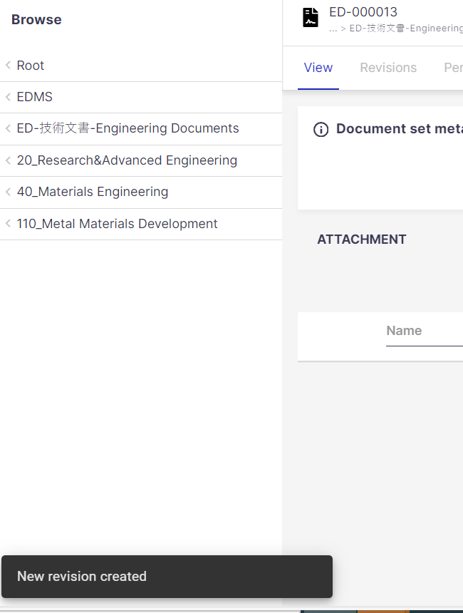
1.Revise Document Version
Step 2: Select [Create a new revision] icon on top right cornet to revise as below steps
①
② Pop-up message appears. Click [OK]
① Click [Create a new revision] icon
②
④
③
③ Confirm message [New revision created] shown in bottom left corner.
④ Confirm status of revised report is [Draft] and [Revision] is changed.

Slide 5
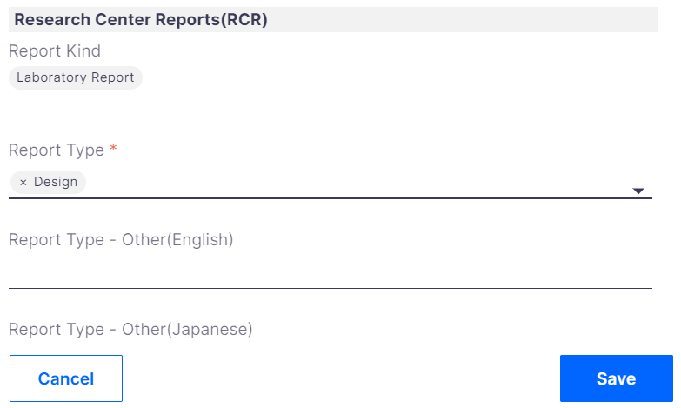
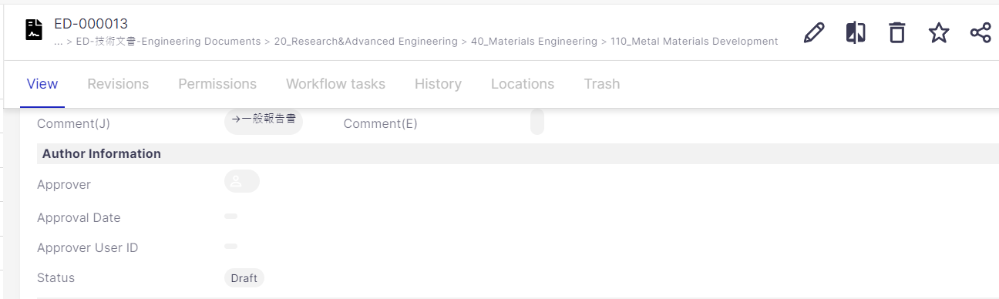
2.Edit Document attribute
You can edit attributes of document you registered as below steps.
※Condition to edit: Status of target document is [Draft]
※Author can only edit the document attribute.
①
①From icon list on top right corner of Document detail screen, click [Edit document] icon
②
②Registration screen shows. You can edit target attributes you want and click [Save] button.

Slide 6
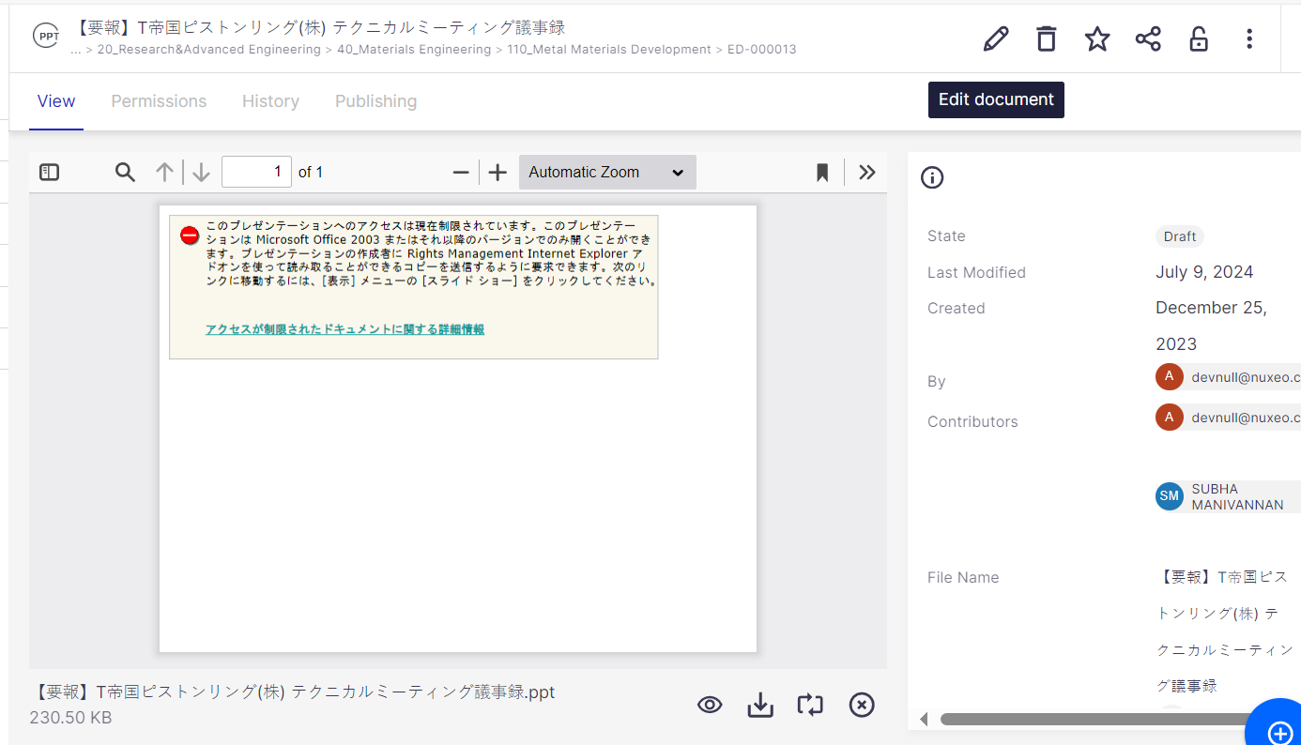
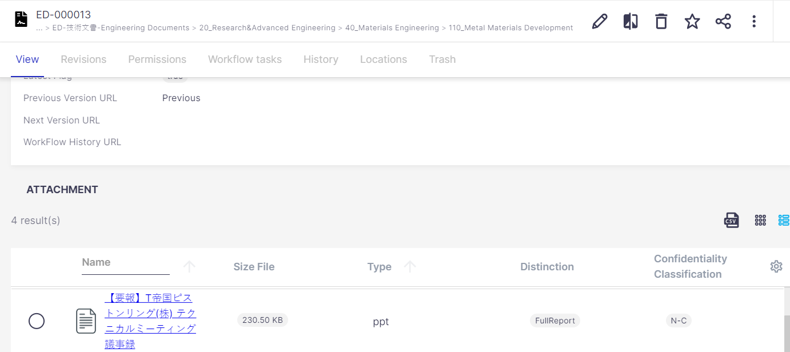
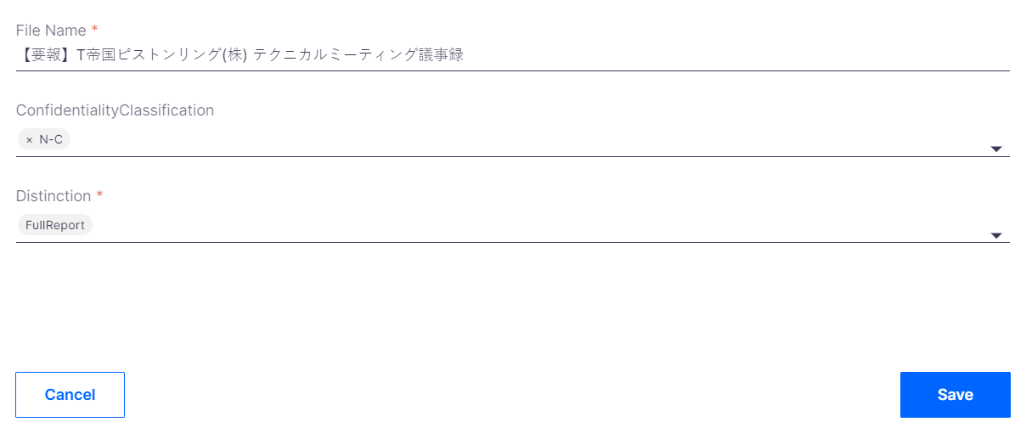
3.Edit attribute of attachment
You can edit attributes of attachment you uploaded in the document you registered as below steps.
※Condition to edit: Status of target document is [Draft] ※Author can only edit the attributes of the attachment.
②
② File preview screen appears. From icon list in top right corner, click icon [Edit document]
①
①Select target attachment file you want to edit from attachment list of report
③
③File attribute registration screen shows. Edit target attribute you want and click [Save] button.

Slide 7
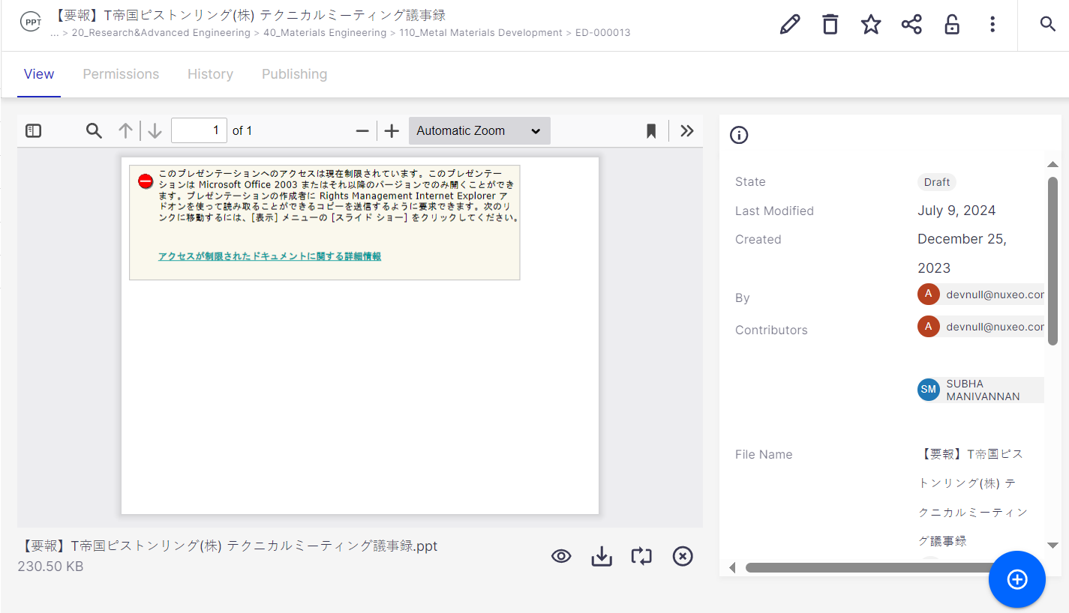


4.Replace/Remove attachment
You can replace or remove the attachment of document you registered from here.
※Condition to replace: Status of target document is [Draft]
※Author only will be able to replace attachment.
You can select one of below two icons to replace file.
① [Replace] button: click this button and replace
a new file
②[Remove] button: click this button to delete current file first, then upload a new file.
①
②

Slide 8
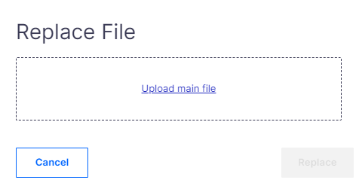
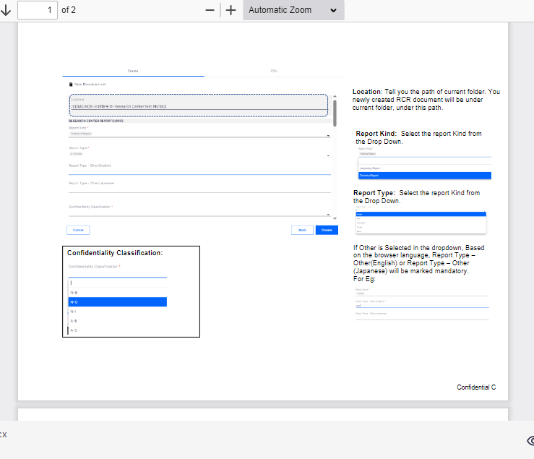
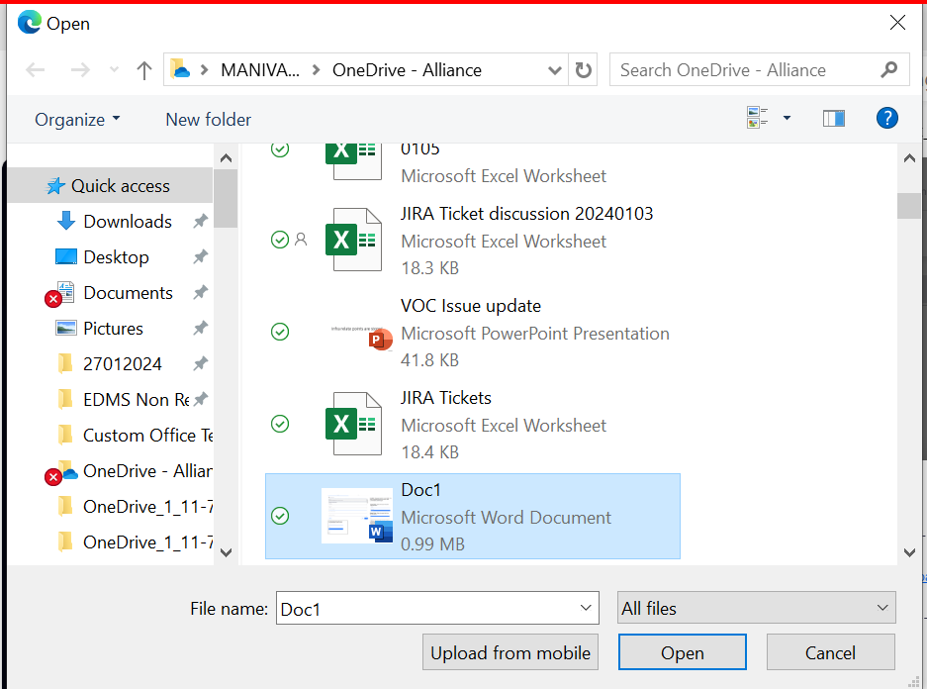
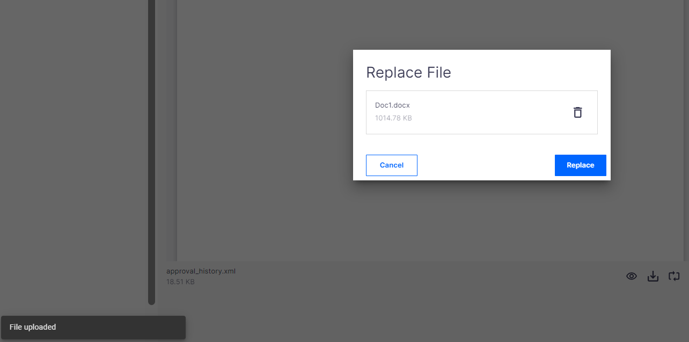
①Replace:
② Click here to upload required file
① click this button to replace
a new file
①
⑤ The File got replaced
③ Select the required file
④ Click on Replace

Slide 9
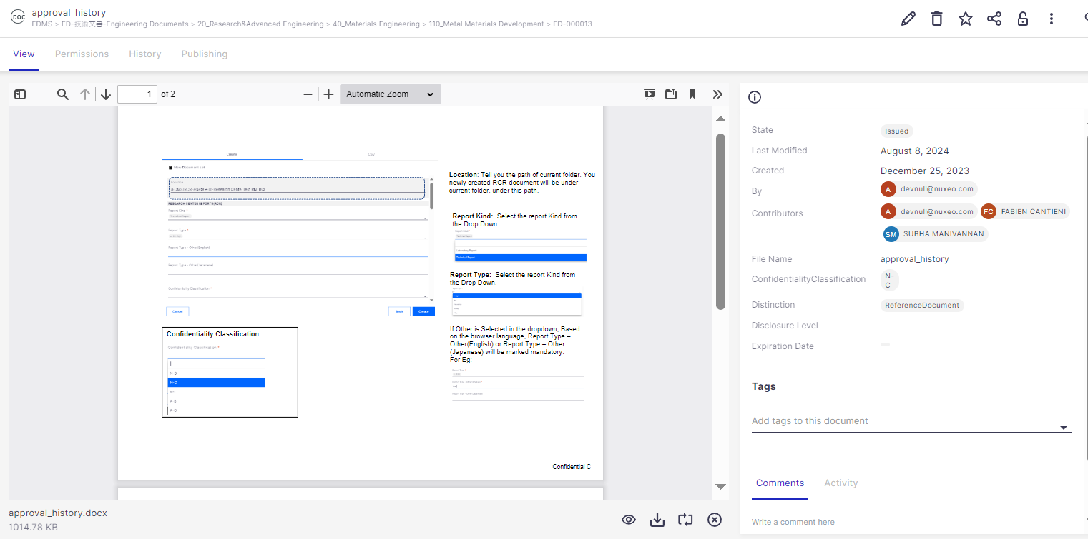
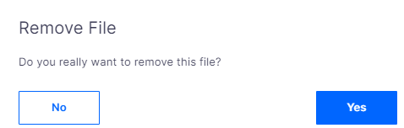
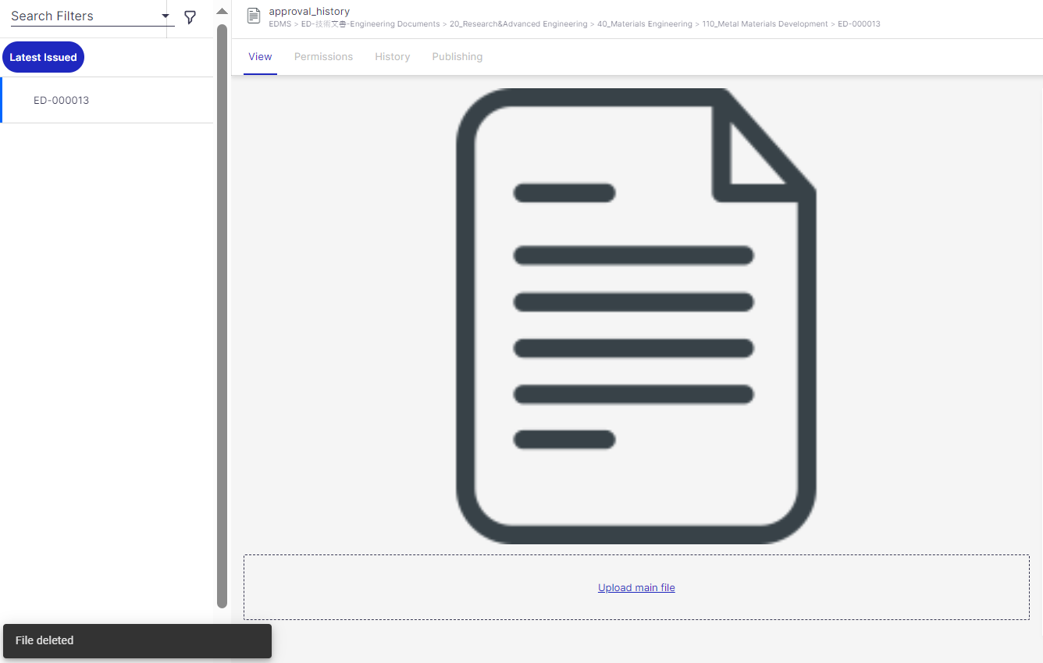
② Remove:
③ Select Yes
① Open the file
② Click on Remove button.
④ The. File is removed

Slide 10
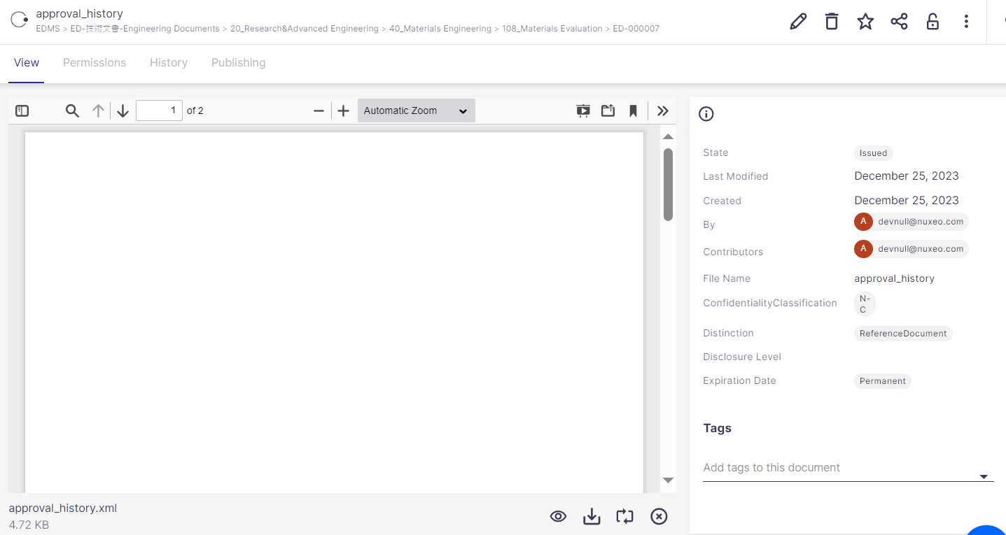

5.Download attachment of document
You can download attachment of document by one of 3 following methods.
※ED Users will be able to download attachment.
Method 1: If you want to download current opening file, you can click on [Download] button from icon list in bottom right corner of file preview screen.
Method 1: Click [Download] button on file preview screen to download current opening file.

Slide 11
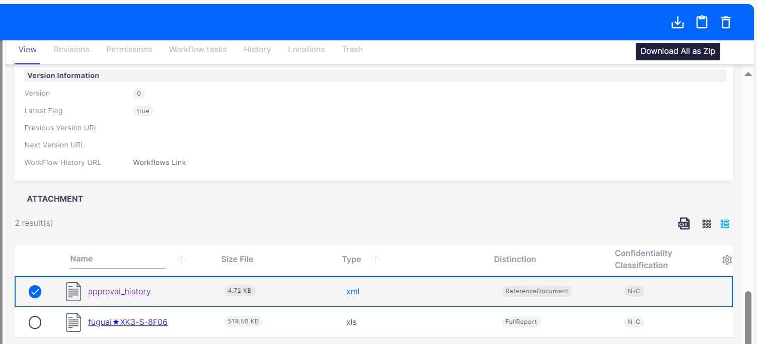
5.Download attachment of document
Method 2: If you want to download multiple files of a report, you can select target file from attachment list and click [Download All as Zip] icon on top right corner.
Method 2: Select target file and click [Download All as Zip]

Slide 12
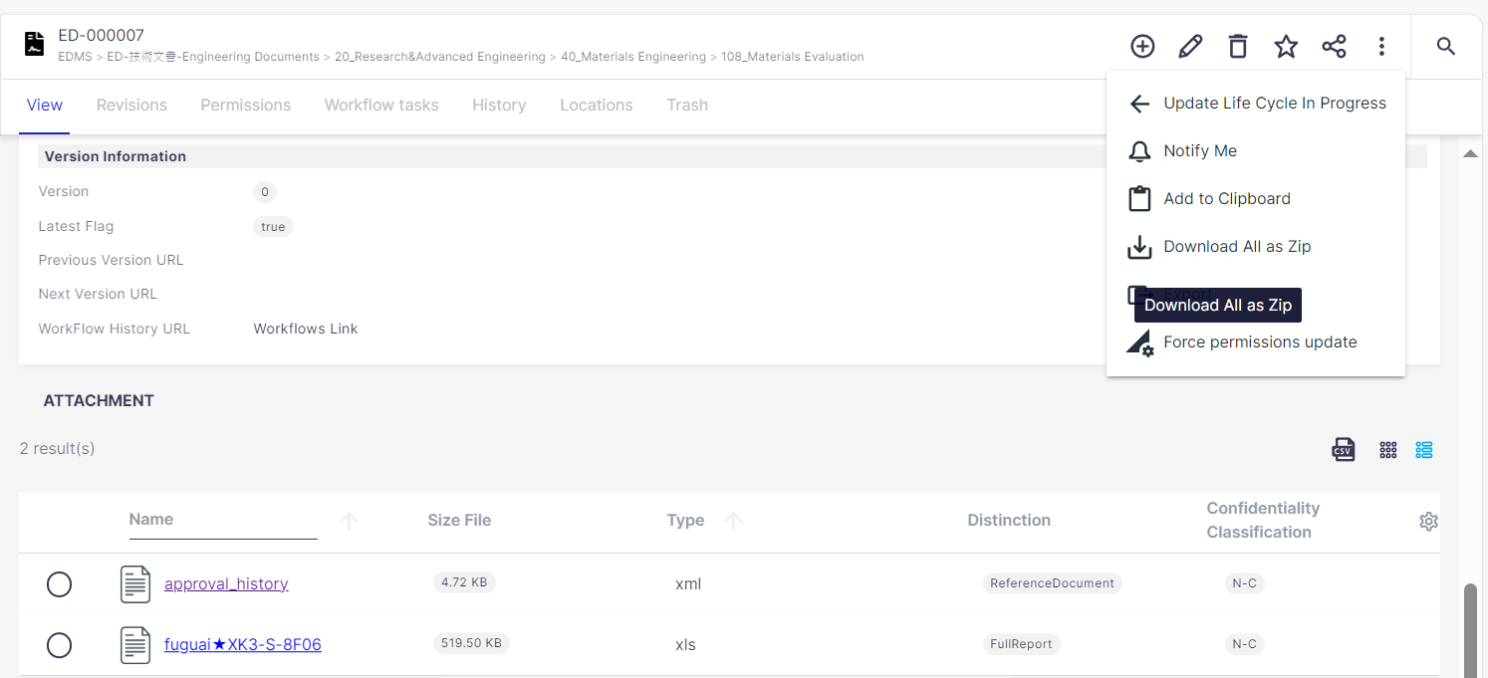
5.Download attachment of document
Method 3: If you want to download all attachment of a document in one shot, you can select […] icon on top right corner of document detail screen and select [Download All as Zip]
Method 2: Select target file and click [Download All as Zip]

Slide 13
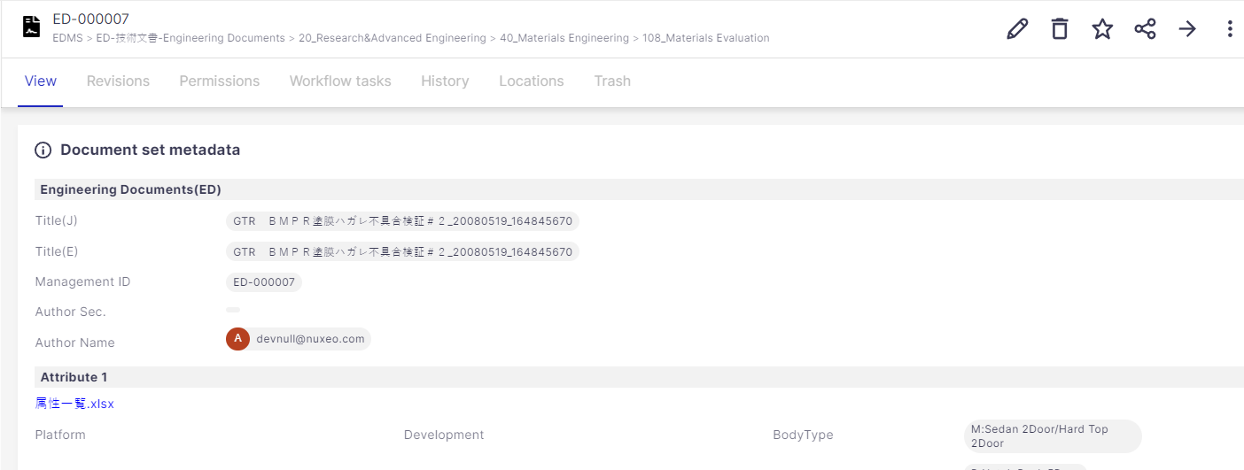
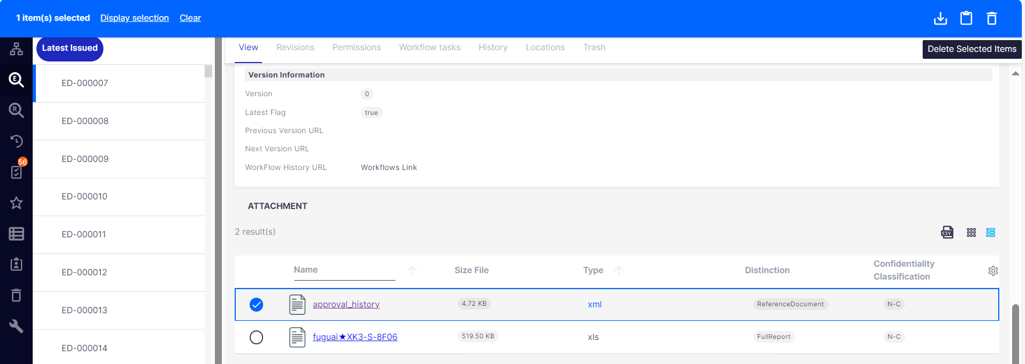
6.Delete document/Attachment file
You can delete report you registered or attachment file of document as below.
※IS/IT Administrator/ED Biz Administrator can delete the document set and attachment.
＜Delete document>
From icon list in top right corner of document detail screen, select [Delete document] icon to delete as needed
＜Delete attachment>
②
② Select [Delete
Selected Items]
If you want to cancel deletion, you can click [Clear] button
①
①Select target file you want to delete from attachment list

Slide 14

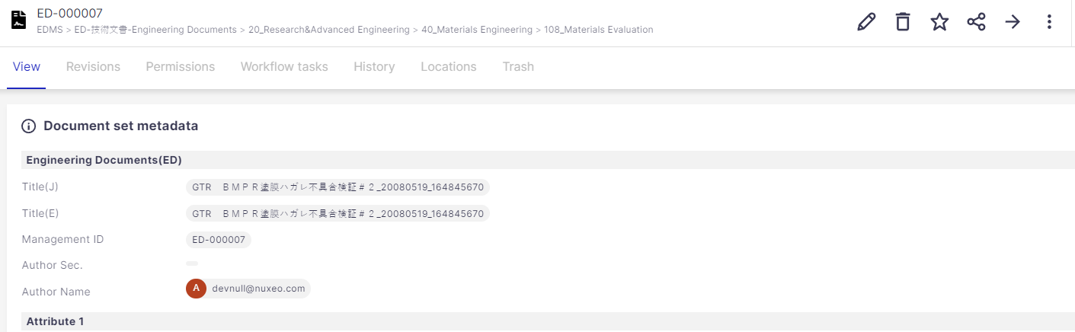

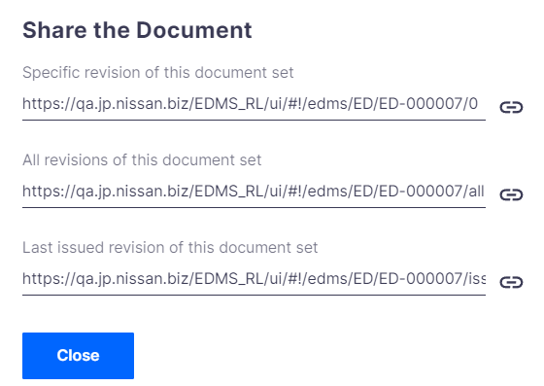
7. URL Share
If you want to share a URL of report or attached file you are currently viewing, click Share button as below.
②Click [Copy Link] icon in right side to copy link. Then you can paste it to other window like notepad to use
①
①Click [Share] Icon
②
Link①
Link②
Link③
Link①：To view specific revision of current document.
Link②：To view all revisions of target document.
Link③：To view latest issued revision of target document
※Please note that user Viewer right only unable to access link ①＋②. Please choose correct URL to share.

Slide 15

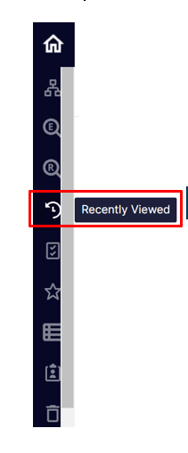
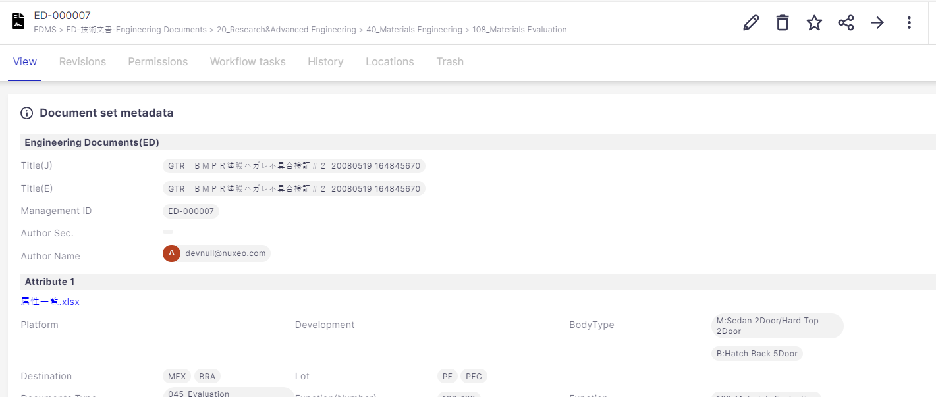
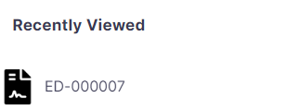
8. Recently Viewed
On the navigation bar, the “Recently Viewed” button displays information you have recently viewed.
If you want to view it again, click on the target document or File, the information will be displayed in the field on the right side as below image.
Click !

Slide 16

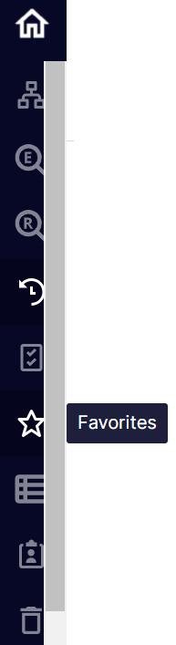
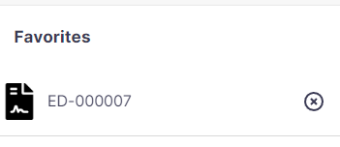
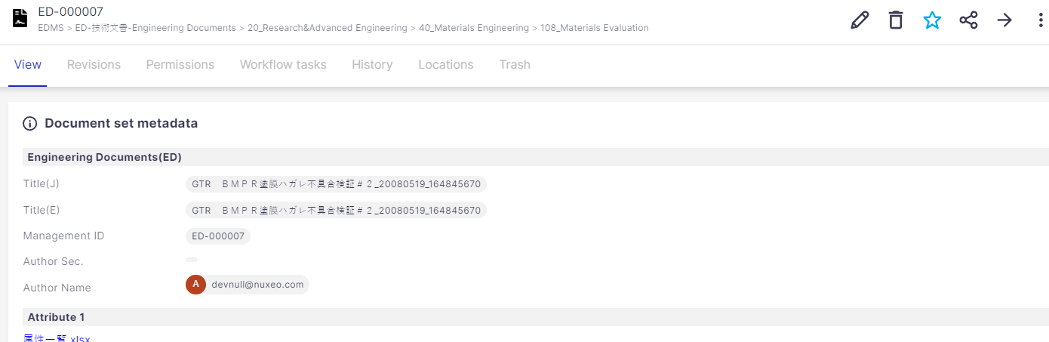
9. Favorite
When you click “Favorite” button on the navigation bar, the information registered as a favorite is immediately displayed.
If you want to register any report or file to Favorite list, you can click button on the top upper corner of current document you are viewing to add to Favorite
Click here to remove this item from Favorite list

Slide 17
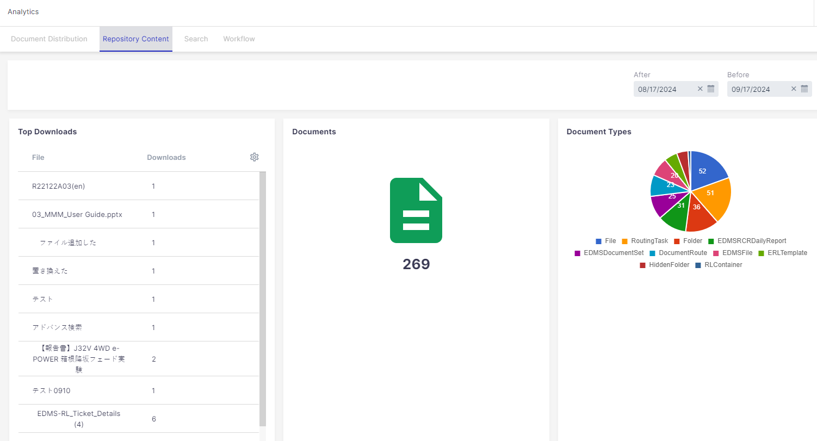

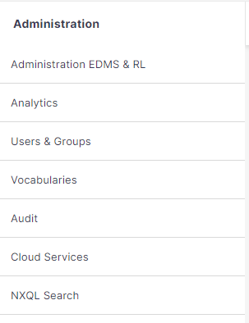
10. EDMS RL Analytics (For IS/IT, Biz Admin)
There are 2 ways for accessing EDMS/RL analytics:
Way 1: Go to Administration Tab and select Analytics: (This Option is available only for IS/IT Administrators).
Select this tab

Slide 18
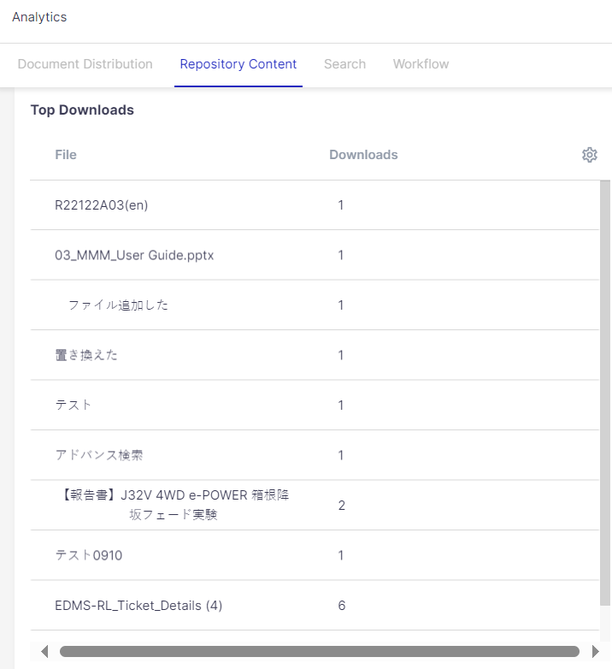
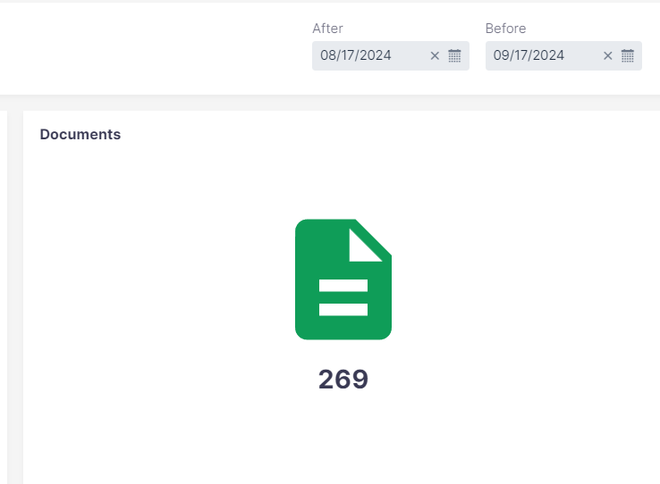
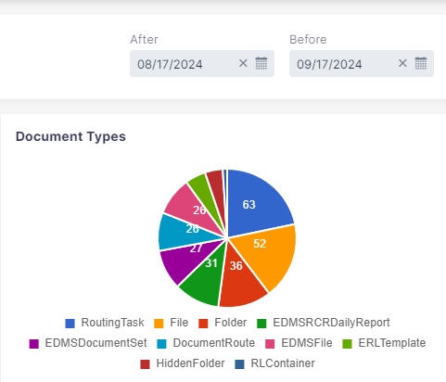
Refers to number of Document Sets + files for EDMS + RL Application categories which was created (Including Draft + InProgress + Issued Documents) during the above-mentioned time-duration.
Refers to the most downloaded RL/EDMS documents
Refers to number of Document Sets + files for EDMS + RL Application categories which was created (Including Draft + InProgress + Issued Documents) during the above-mentioned time-duration based on the type of files/Document set.

Slide 19
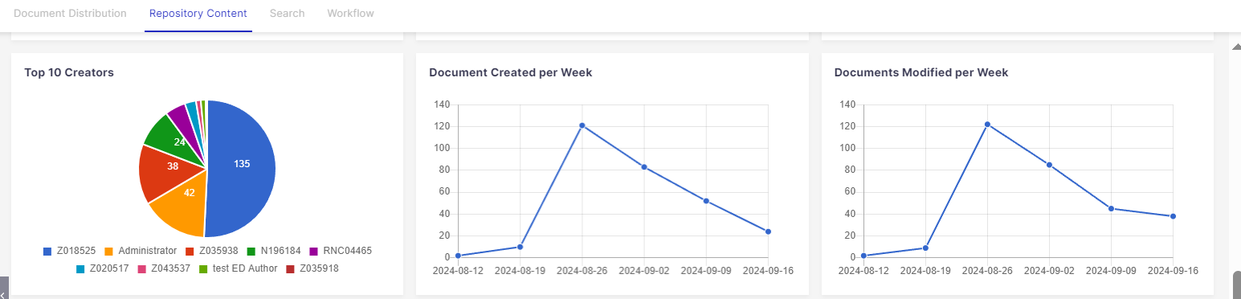
Top 10 Users who have created most of the document sets/files
Document sets/files created / Modified on Weekly basis.

Slide 20
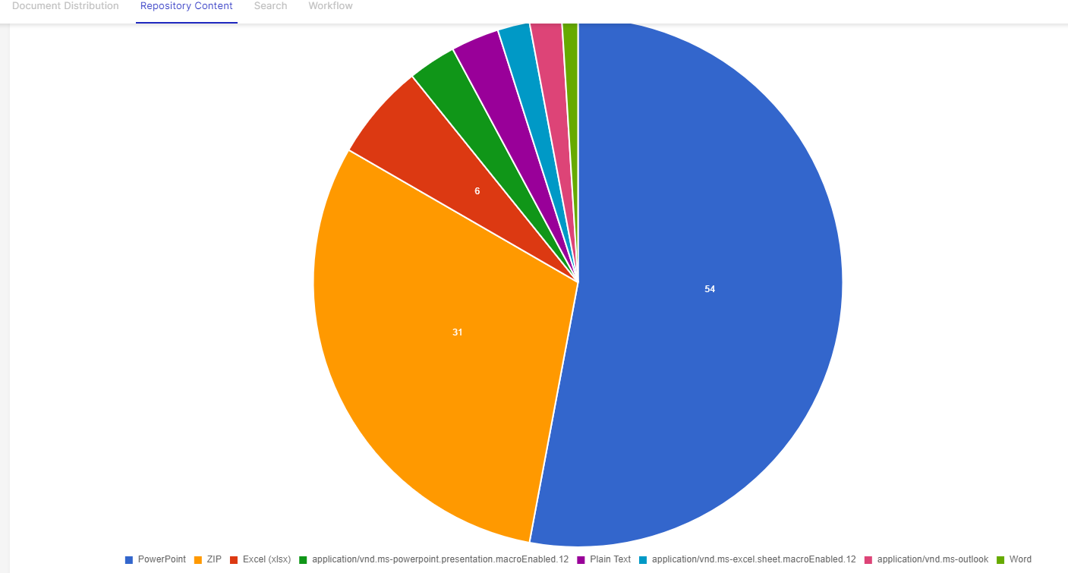
A
Type of the files uploaded in RL / EDMS categories.
Apart from the above charts, we can check the analytics of Workflow data:

Slide 21
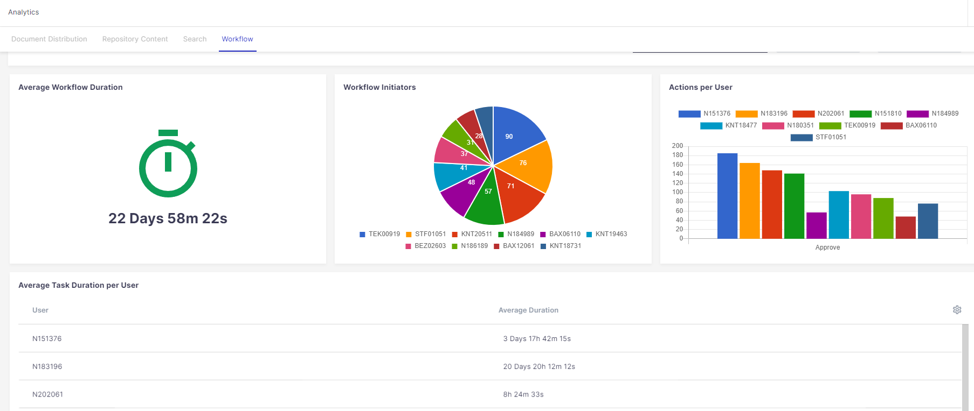
Count of Workflow created by the Workflow initiator
Average duration taken to complete a Workflow
Count of Workflow Approved
Average duration taken to complete a Workflow by each user

Slide 22
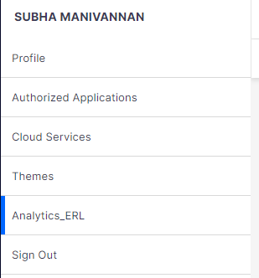
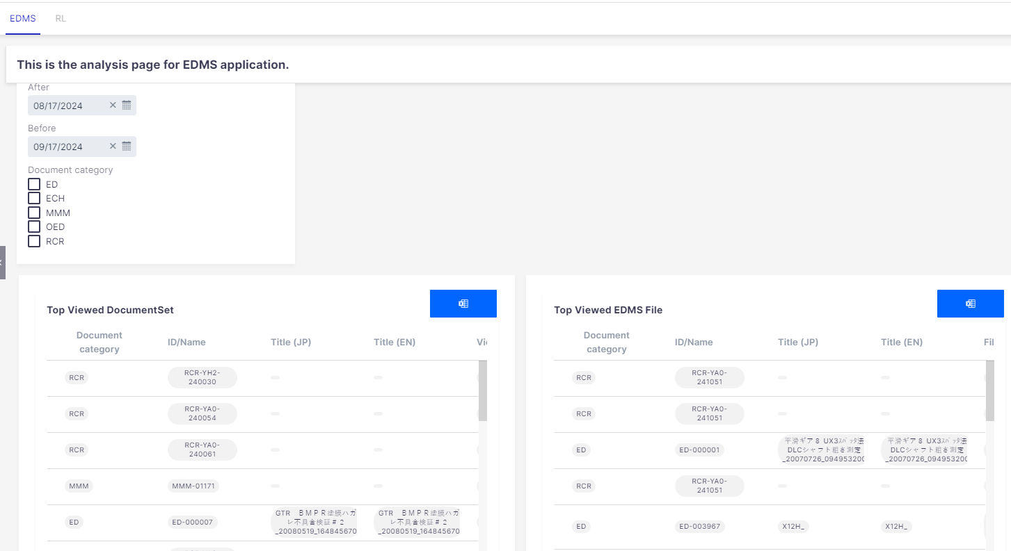
Way 2: Go to Profile, Select Analytics_ERL: (This Option is available only for IS/IT Administrators and Biz Administrators).
Select the time period for which the data to be checked.
Select required category. (one/Multiple/all categories can be selected)
Most viewed Files details
Click on this Icon to export the details in Excel format.
Most viewed document set details

Slide 23
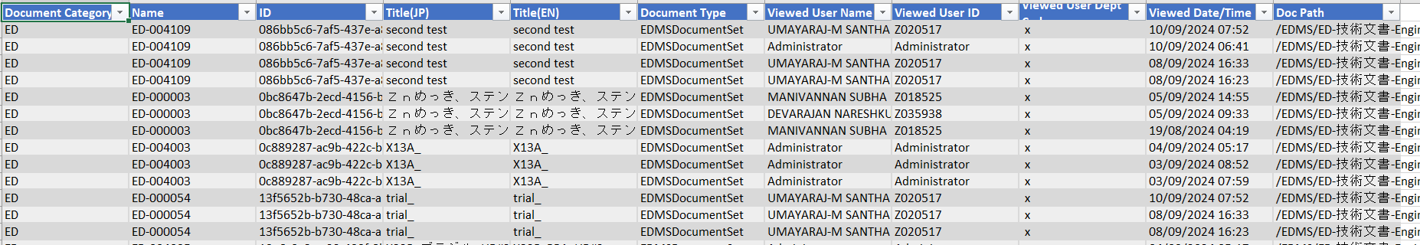
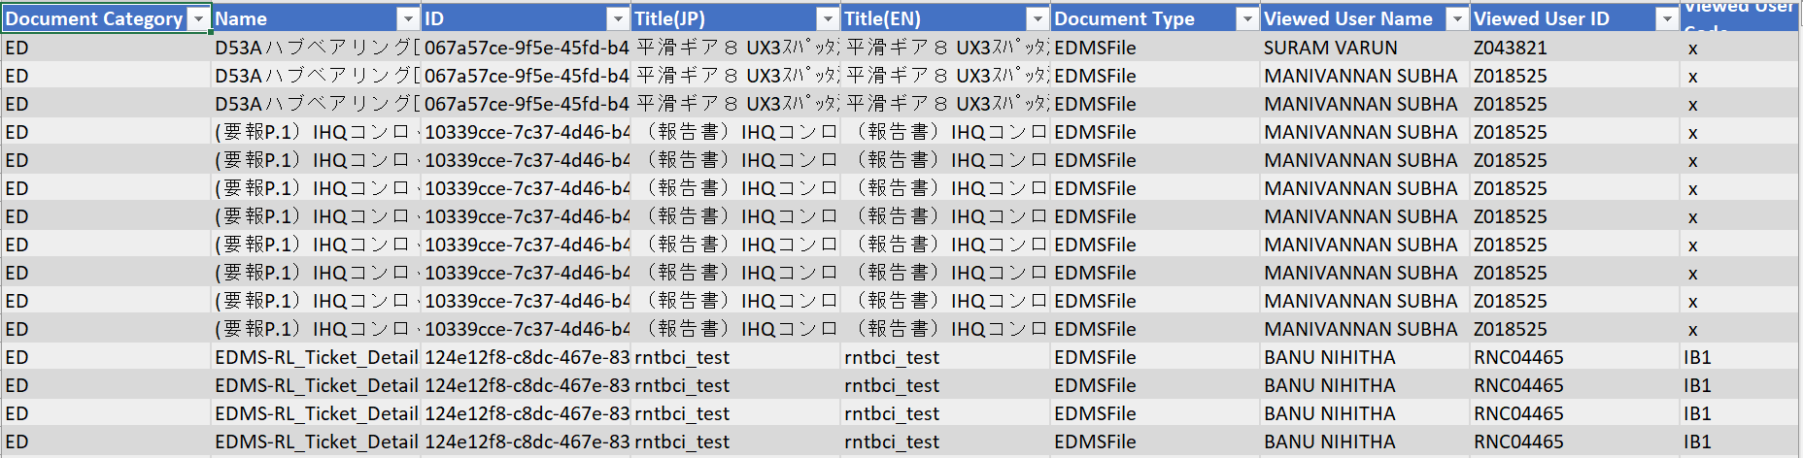
The Exported data appears as below:
For Document Sets:
For Files:

Slide 24
Thank you

